Slide 1
Project 2: Code Comment Classification
Using Machine Learning and Deep Learning for Multi-Label Classification of Code Comments
Presented by: Luca Francesco Macera and Calogero Carlino
Dataset: NLBSE’23 Tool Competition Dataset (6,738 samples)
Link: https://nlbse2023.github.io/tools/

Slide 2
What is Code Comment Classification?
Code comments are natural language annotations in software code.
They describe the purpose, functionality, or behaviour of code.
Automatically classifying comments helps in:
Improving software documentation.
Enhancing code readability and maintenance.
Enabling better developer tools and automated summarization.

Slide 3

Problem
Goal: Develop a model to automatically classify code comments into multiple relevant categories.
Challenges:
Comments can belong to more than one class (multi-label classification).
Comments are short and context-dependent.
High variability in wording and style between developers.

Slide 4
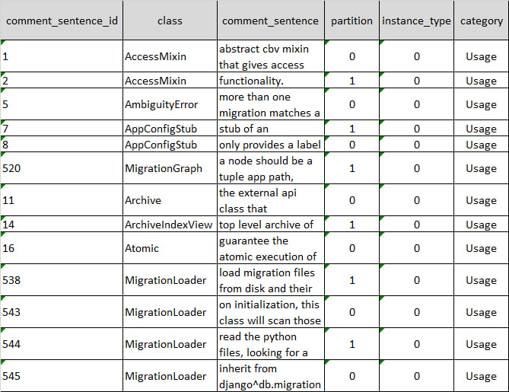
Dataset Overview
Source: NLBSE’23 Tool Competition Dataset
Total classes: 6,738
Data type: Actual sentence string
Format: each row represent a sentence (aka an instance) and each sentence contains multiple labels
Task: Predict comment class

Slide 5
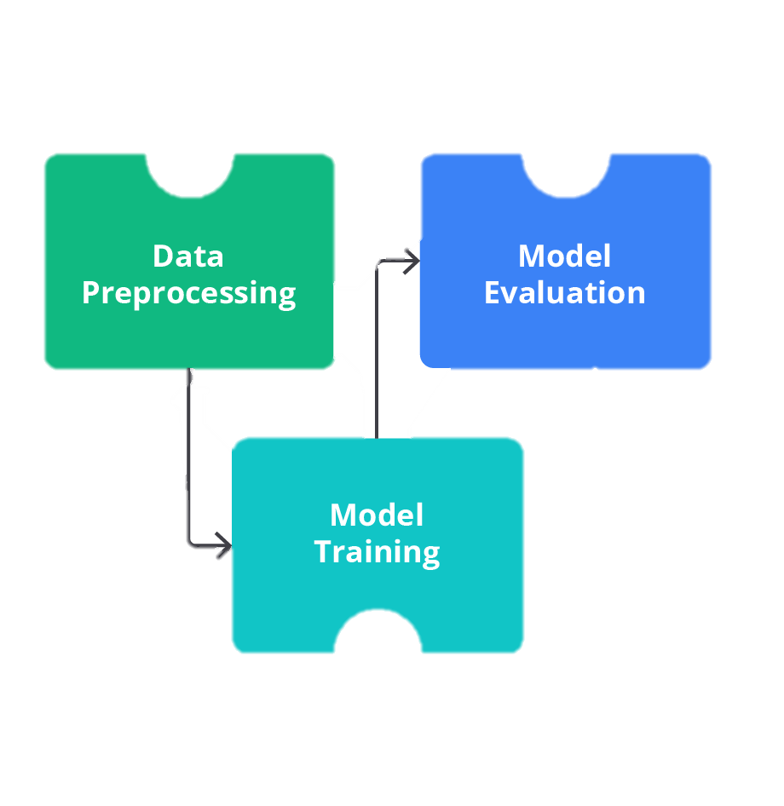
Methodology
Data Preprocessing
  Clean and tokenize text
  Handle class imbalance (if present)
Model Implementation
  Apply Machine Learning (e.g., SVM, Random Forest) or Deep Learning (e.g., LSTM, BERT, RoBERTa) classifiers
Evaluation Setup
  Use k-fold cross-validation
  Evaluate using metrics such as F1-score, Precision, Recall

Slide 6
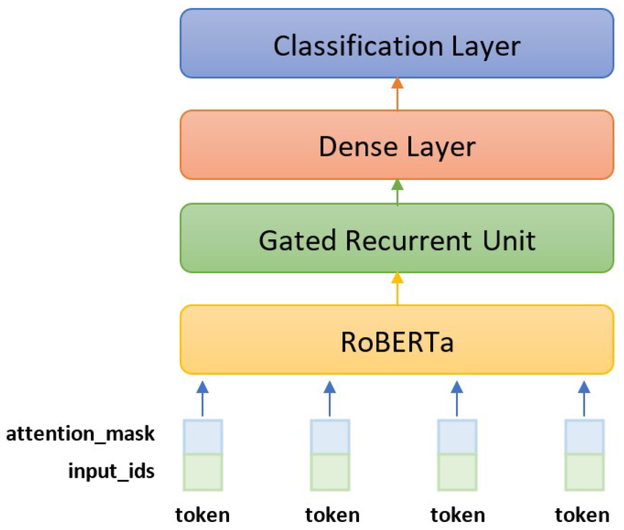
Evaluation and Comparison
Compare model performance against baseline models (Transformer-based RoBERTa baseline)
Use multi-label metrics for fair evaluation
Analyze and interpret results to identify improvement areas

Slide 7
Expected Outcomes
Most effective ML/DL techniques for comment classification
Gain insights into linguistic patterns in code comments
Provide recommendations for better automated documentation tools

Slide 8
Why Code Comment Classification Is Useful
Improves Software Maintenance
  Helps developers quickly understand the intent and functionality of code.
  Facilitates bug fixing, feature updates, and onboarding of new team members.
Enhances Documentation Quality
  Automatically organizes and categorizes comments.
  Detects missing or outdated documentation.

Slide 9
Why Code Comment Classification Is Useful
Enables Better Developer Tools
  Powers intelligent search and recommendation systems in IDEs.
  Supports automated documentation generation and code summarization.
Supports Software Analytics
  Provides insights into developer behavior, code quality, and project evolution.
Saves Time and Effort
  Reduces manual labeling and review of large codebases.
  Streamlines workflows in large software projects.

Slide 10

Future Work
Extend dataset with more repositories
Incorporate code context (not just comments)
Fine-tune advanced transformer models for domain-specific optimization

Slide 11
Project 2: Code Comment Classification
Using Machine Learning and Deep Learning for Multi-Label Classification of Code Comments
Presented by: Luca Francesco Macera and Calogero Carlino
Dataset: NLBSE’23 Tool Competition Dataset (6,738 samples)
Link: https://nlbse2023.github.io/tools/

